Slide 1
Capstone Project 1
Global Terrorism Analysis
Team Members -
Jagdish Tawar
Chaitanya Inamdar
Pritam Gangwar

Slide 2
Points for Discussion
Introduction
Problem Statement
Data Summary
Data Analysis
Missing Values
Distribution of Numerical Values
Graphs
Correlation Matrix
Challenges
Conclusion

Slide 3
Problem Statement
Analysis Based on Country wise Attack
Analysis Based on Year wise Attack
Analysis Based on Region wise Terrorist Activities
Analysis Based on Casualties
Analysis Based on Terrorist Group
Analysis Based on Attack Type
Analysis Based on Cities
Analysis Based on Targets for Attack

Slide 4
What is Terrorism ?
The systematic use of violence by a group in order to intimidate a population or coerce a government into granting its demand through bombing, kidnapping, hijacking, taking of hostages, indiscriminate killings and assassination.

Slide 5
Data Summary
global_terrorism_df :- It contains all the information regarding Total Attacks, Countries, Regions of different world, Casualties because of attack, Terrorist Groups etc. from the year 1970 to2017.
country_attack :- It contains the information regarding the Countries in which attack happened.
region_df :- It contains different world wide Regions in which Terrorist activities happened. E.g.-Eastern Europe, Middle East etc.
attack_type_df :- It gives information regarding the type of attack done by Terrorist.
group_df :- It gives information regarding the different Groups of Terrorists which do attacks globally. E.g.-Taliban, ISIS etc.
city_df :- It gives information regarding the different cities from countries where the most attacks and casualties happened.

Slide 6
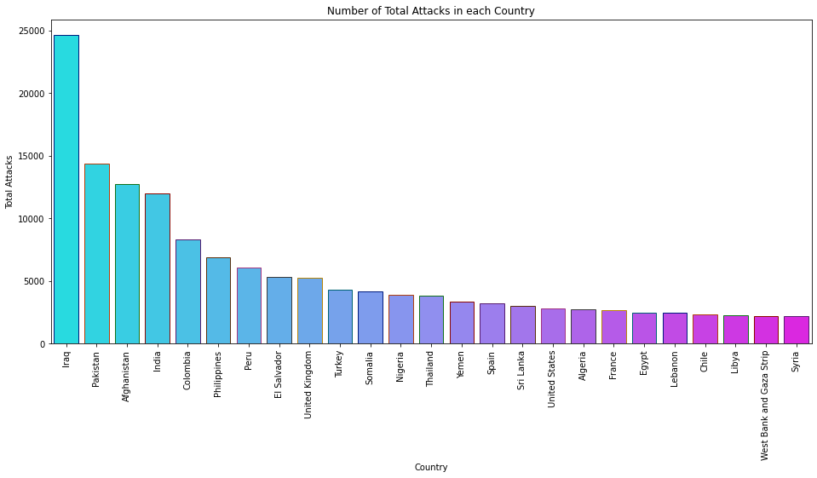
Country wise Attack
In the top 25 Countries Iraq is most affected country which is at 1st place and Syria is at 25th position.
The total attacks in Iraq is near about 25000 .
Our India as at 4th place and the total attacks in India are near about 12000.
There is huge gap between top two countries i.e. Iraq and Pakistan . Iraq has around 10000 more attacks than Pakistan.
Its clear that Iraq is highly affected country.

Slide 7
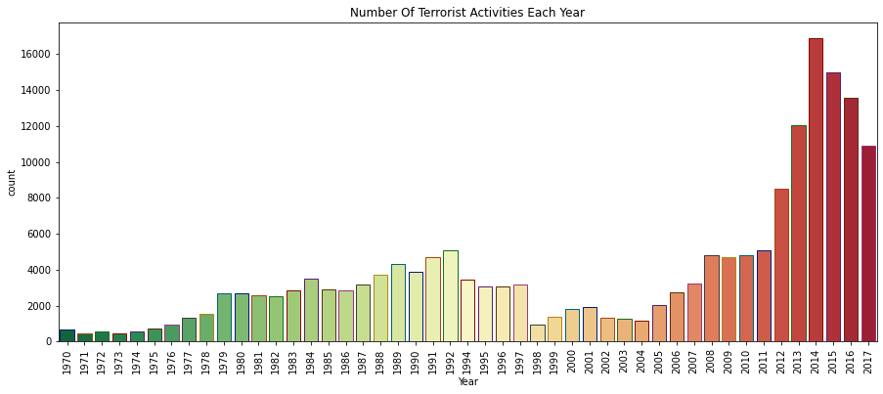
Year wise Attack
From 1970 to 2017 , The year of 2014 can be considered as most affected year. In 2014 the number of attacks are 16903.
Least number of attacks are in the Year of 1971, which are around 471.

Slide 8
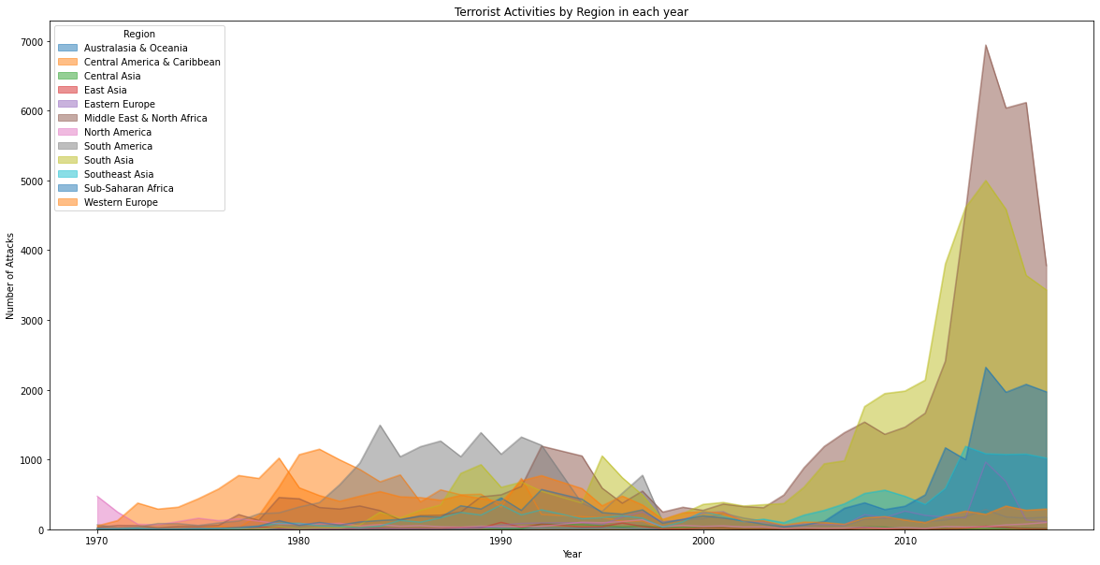
Region wise Terrorist Activities
The plot shows 12 different regions from world wide which are attacked by Terrorists.
Most number of attacks are in Middle East & North Africa ,i.e. 50474 attacks were happened.
Least number of attacks are in Australasia & Oceania ,i.e. 282 attacks were happened.
The graph has taken a sudden raise from 2005.

Slide 9

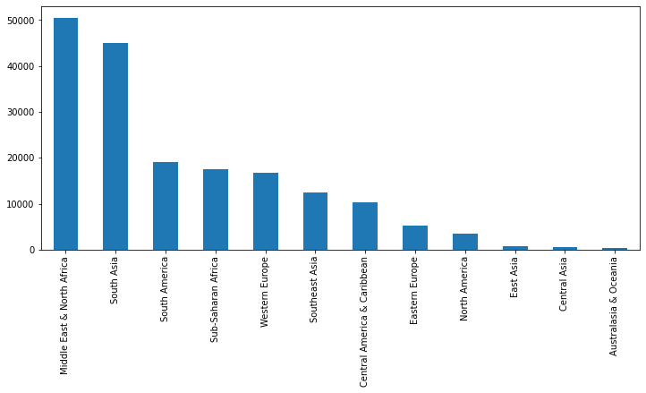

Slide 10
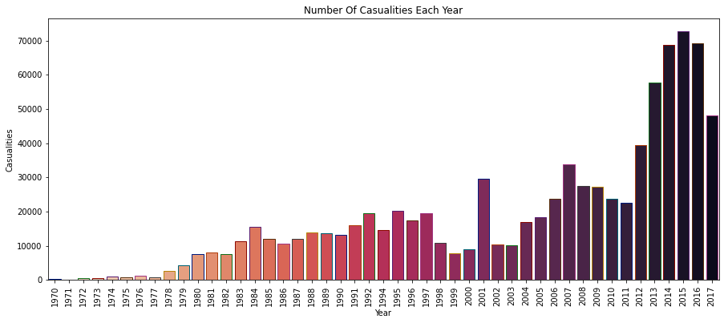
Casualties due to Attack
1] Year wise Casualties- ( Killed + Wounded )
The most number of Casualties are in the Year of 2015, which are more than 70000 in a single year.
The least number of Casualties are in the Year of 1971, which are around 255.
Casualties are increased rapidly from 2012 to 2017.

Slide 11
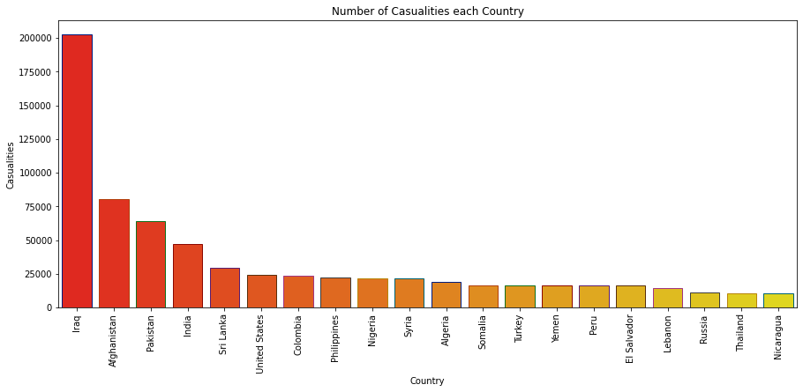
2] Country wise Casualties-( Killed + Wounded )
The graph shows the top 20 countries which have higher Casualties in which Iraq is at 1st position ,i.e. approx. 200000 casualties are there.
Nicaragua is at 20th position having total casualties less than 25000.
India is at 4th position having total casualties of near about 50000.
Iraq is the most affected country.

Slide 12
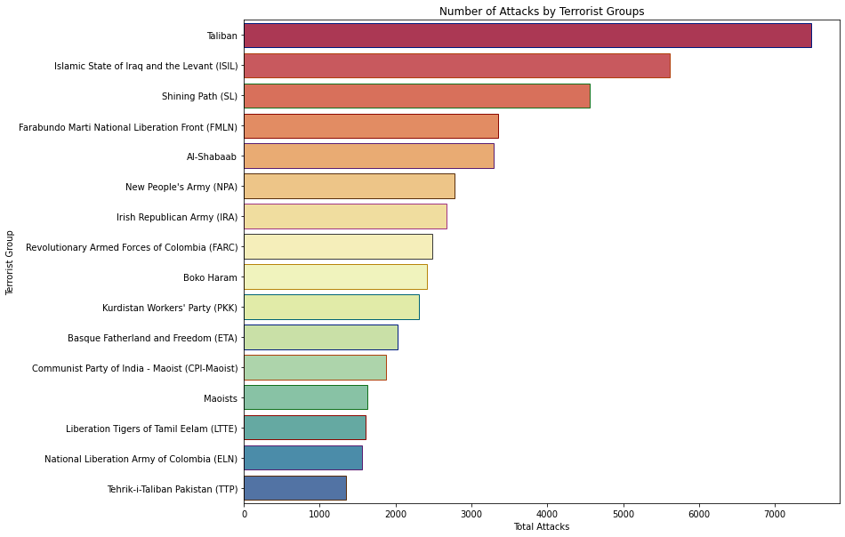
Terrorist Groups
There are 16 Terrorist Groups who are responsible for Terrorist activities.
Taliban is at 1st position who made highest attacks globally ,i.e. 7478 attacks.
Tehrik-i-Taliban Pakistan (TTP) is at 16th position . i.e. 1400 attacks by TTP.
The most number of Casualties are from Islamic State of Iraq and the Levant (ISIL) group.
The least number of Casualties are from Revolutionary Armed Forces of Colombia (FARC) group.

Slide 13
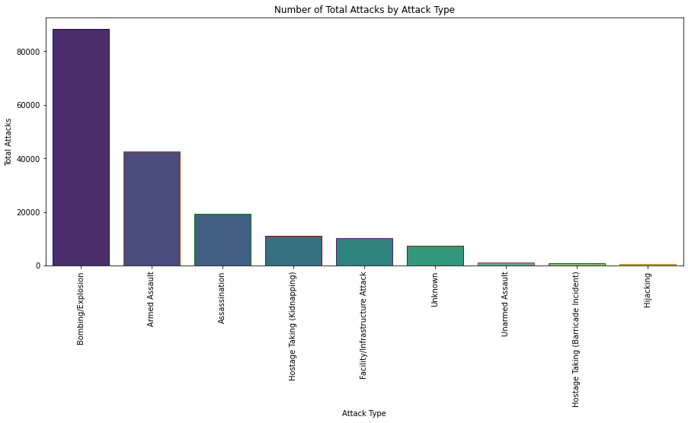
Type of Attack
Over 80000 attacks are of Bombing /Explosion type and the second most type of attack used is Armed Assault which is around 40000 attacks.
The least type of attack used is Hijacking.

Slide 14
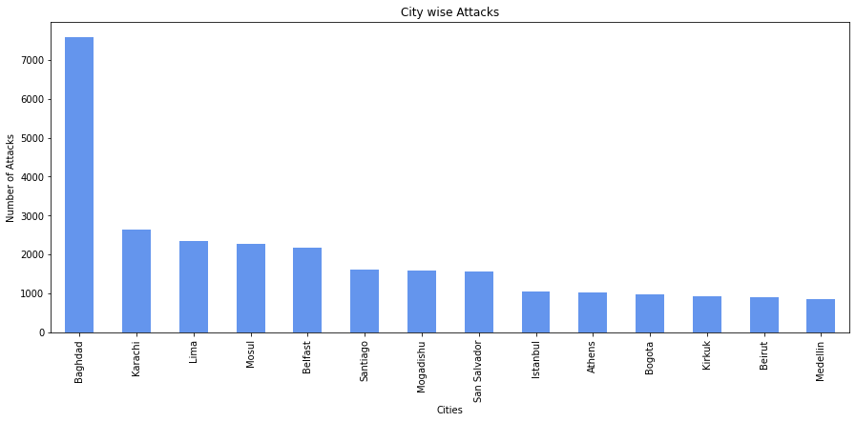
Analysis of Cities
Top 14 cities are plotted on graph according to most attacks, here the Baghdad is the hotspot for attack. More than 7000 attacks are happened in Baghdad.
Medellin is at 14th place and attacks happened in Medellin are near about 1000.
Karachi is at 2nd place but still there is huge gap of no. of attacks happened between Karachi and Baghdad, i.e. attacks in Karachi = approx. 3000 attacks.

Slide 15

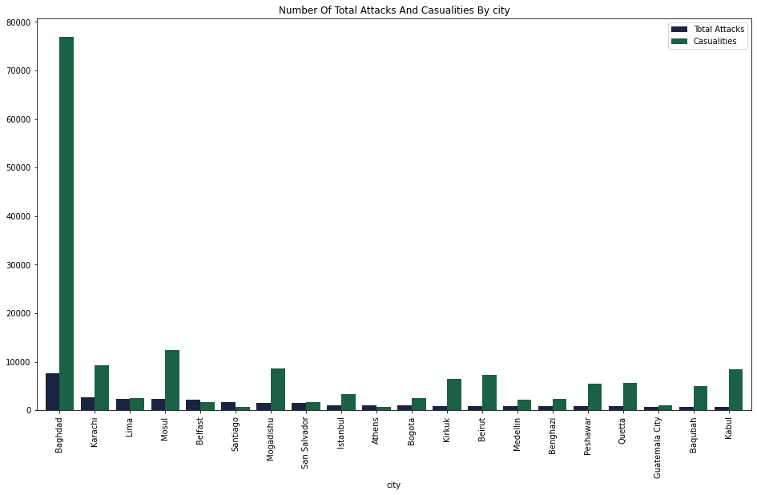
Comparison Graph with Casualty.

Slide 16
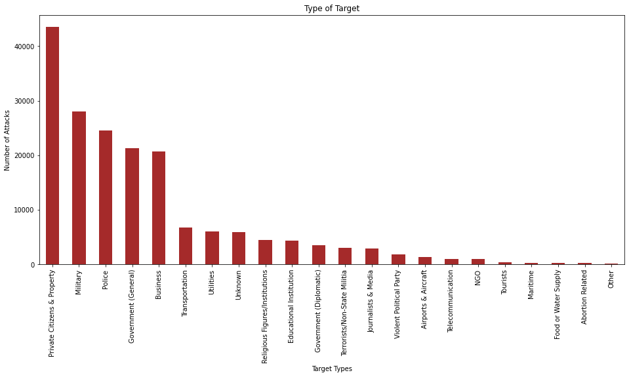
Target for Attacks
The most targeted category for attack is Private Citizen & Property. Over 40000 attacks were happened in this category.
The top 5 categories are mostly targeted by Terrorists.
Abortion related, Food &water supply related categories are very least targeted categories.

Slide 17
Challenges
There was too much data available in the csv file. To get meaningful data and arranging them was a challenge.
There was lots of null values in the Data set.
Team mates have given different names for data frames. Combining them was a challenge.
Understanding the errors while coding and eliminating them was a challenge.

Slide 18
Conclusion...
After analysing all the data of years between 1970 – 2017 and graph we can conclude that-
Iraq is the hotspot of Terrorism . Most of the attacks are occurred in Iraq. Pakistan is at 2nd place . After Pakistan , Afghanistan and India are at 3rd and 4th position viz. Similarly the least number of attacks were occurred in Turkey.
In terms of Casualty also Iraq can be considered as most affected country because very high amount of casualties due to terrorism is in Iraq. But Philippines can be considered as least affected country in terms of casualty.
The Year 2014 is considered as the most attacked year in the span of 47 years. Similarly the Year 1971 is least attacked year.
Middle East & North Africa is the hotspot region for Terrorist activities. Because of that the amount of casualties in that region is also high. We know that all the Trade Business is very active in this region. Hence the effect of terrorist activities are seen in world wide.
If we talk about a specific city then Baghdad is most affected city the world. It is very obvious because Baghdad is the capital of Iraq. Athens is the city which can be considered as least affected city.

Slide 19
Conclusion contd. . .
The Taliban can be considered as most active Terrorist group among all the groups. More than 7000 attacks were done by Taliban. ISIL ( Islamic State of Iraq and Levant ) is the second most active group.
Most number of Casualties are occurred because of ISIL group.
Private Citizens & Property, Military, Police, Government, Business are the targeted categories by Terrorist groups.
The total humanities affected from 1970 to 2017 due to Terrorism are around 935737.

Slide 20
Impact of Terrorism
Economic-
Loss of life and property.
Loss of Businesses like Tourism, Airlines.
Loss of Government Property.
Political-
Tightening of border security and immigration clearance.
Restrictions on individual freedom and personal privacy.
Social-
Destruction of energy system.
Damage to water supply system.
Damage to communication system.

Slide 21
Thank You

